Slide 1
SOFTWARE DESIGN

Slide 2
Introduction:
The purpose of Design phase in the Software Development Life Cycle is to produce a solution to a problem given in the SRS(Software Requirement Specification) document. The output of the design phase is Software Design Document (SDD).
Basically, design is a two-part iterative process. First part is Conceptual Design that tells the customer what the system will do. Second is Technical Design that allows the system builders to understand the actual hardware and software needed to solve customer’s problem.

Slide 3
Coupling
A measure of the strength of the inter-connections between system components.
Loose coupling means component changes are unlikely to affect other components.
Shared variables or control information exchange lead to tight coupling.
Loose coupling can be achieved by state decentralization (as in objects) and component communication via parameters or message passing.

Slide 4
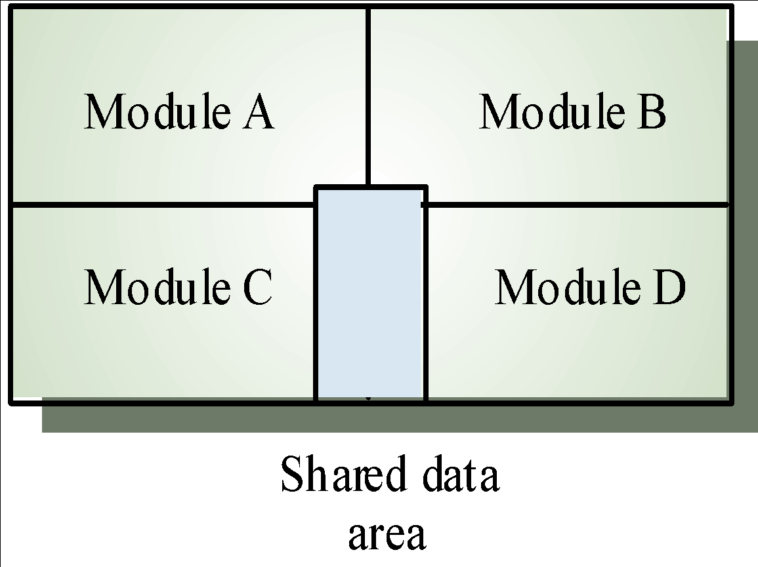
Tight Coupling

Slide 5
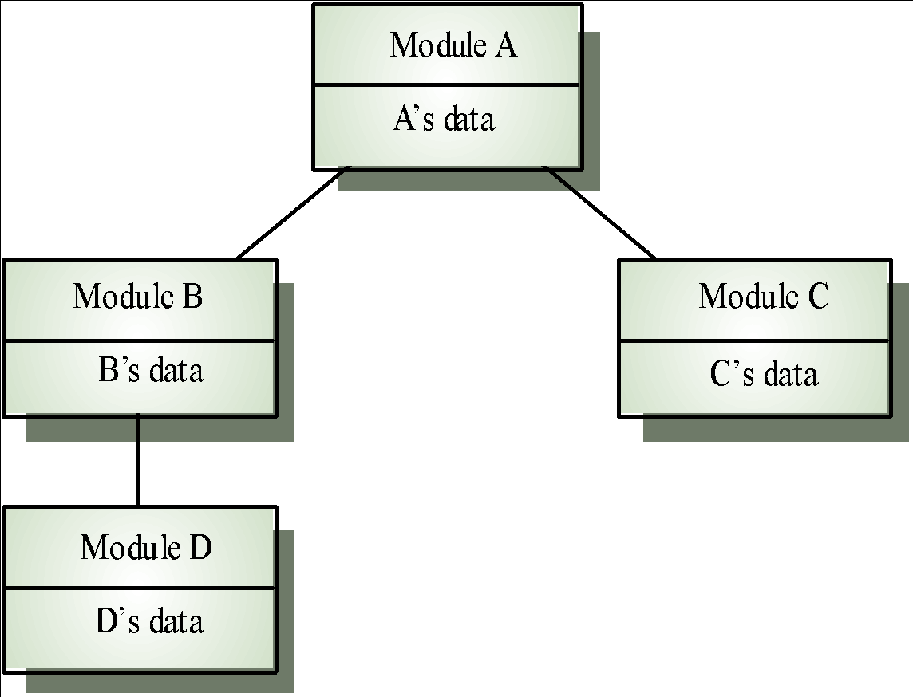
Loose Coupling

Slide 6
Coupling and Inheritance
Object-oriented systems are loosely coupled because there is no shared state and objects communicate using message passing.
However, an object class is coupled to its super-classes. Changes made to the attributes or operations in a super-class propagate to all sub-classes.

Slide 7
Module Coupling
Coupling is the measure of interdependence between modules.
the degree of
(Uncoupled : no dependencies) (a)

Slide 8
Loosely coupled: some dependencies
(B)
Highly coupled: many dependencies
(C)
Fig. : Module coupling

Slide 9
This can be achieved as: Controlling the number of parameters passed amongst modules.
Avoid passing undesired data to calling modules.
Maintain parent/child relationship between calling & called modules.
Pass data, not the control information.

Slide 10
Consider the example of editing a student record in a ‘student information system’.
Edit student record
Edit student record
Student name, student ID, address, course
Student record EOF
Student record EOF
Student ID
Retrieve student record
Retrieve student record
Poor design: Tight Coupling
Good design: Loose Coupling
Fig. : Example of coupling

Slide 11
Data coupling | Best
Stamp coupling
Control coupling
External coupling
Common coupling
Content coupling | Worst
Fig. : The types of module coupling
Given two procedures A & B, we can identify number of ways in which they can be coupled.

Slide 12
Data coupling
The dependency between module A and B is said to be data
coupled if their dependency is based on the fact they
than are
communicate communicating independent.
by only through
passing data,
of data. the two
Other modules
Stamp coupling
Stamp coupling occurs between module A and B when complete data structure is passed from one module to another.

Slide 13
Control coupling
Module A and B are said to be control coupled if they communicate by passing of control information. This is usually accomplished by means of flags that are set by one module and reacted upon by the dependent module.
Common coupling
With common coupling, module A and module B have shared data. Global data areas are commonly found in programming languages. Making a change to the common data means tracing back to all the modules which access that data to evaluate the effect of changes.

Slide 14
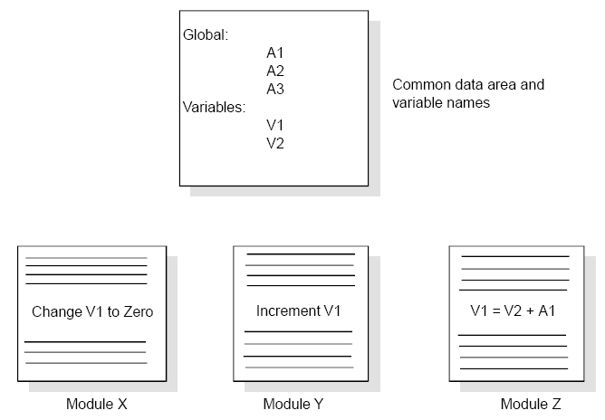
Fig. : Example of common coupling

Slide 15
Content coupling
Content coupling occurs when module A changes data of module B or when control is passed from one module to the middle of another. In Fig. , module B branches into D, even though D is supposed to be under the control of C.
External Coupling:
External coupling occurs when one or more modules share a format, interface or communication protocol, that is imposed upon them. This usually happens when modules are in direct communication with infrastructure layers, e.g., OS functions.

Slide 16
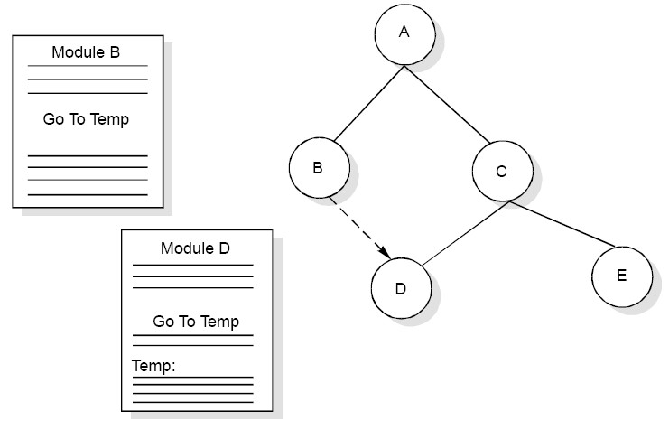
Fig. : Example of content coupling

Slide 17
Module Cohesion
Cohesion is a measure of the degree to elements of a module are functionally related.
which
Module strength
Fig. : Cohesion=Strength of relations within modules

Slide 18
Cohesion
Cohesion: Cohesion is a measure of the degree to which the elements of the module are functionally related. It is the degree to which all elements directed towards performing a single task are contained in the component. Basically, cohesion is the internal glue that keeps the module together. A good software design will have high cohesion.

Slide 19
Functional Cohesion | Best (high)
Sequential Cohesion
Communicational Cohesion
Procedural Cohesion
Temporal Cohesion
Logical Cohesion
Coincidental Cohesion | Worst (low)
Fig. : Types of module cohesion

Slide 20
TYPES
Functional Cohesion: Every essential element for a single computation is contained in the component. A functional cohesion performs the task and functions. It is an ideal situation.
Sequential Cohesion: An element outputs some data that becomes the input for other element, i.e., data flow between the parts. It occurs naturally in functional programming languages.

Slide 21
Communicational Cohesion: Two elements operate on the same input data or contribute towards the same output data. Example- update record int the database and send it to the printer.
Procedural Cohesion: Elements of procedural cohesion ensure the order of execution. Actions are still weakly connected and unlikely to be reusable. Ex- calculate student GPA, print student record, calculate cumulative GPA, print cumulative GPA.

Slide 22
Temporal Cohesion: The elements are related by their timing involved. A module connected with temporal cohesion all the tasks must be executed in the same time-span. This cohesion contains the code for initializing all the parts of the system. Lots of different activities occur, all at init time.
Logical Cohesion: The elements are logically related and not functionally. Ex- A component reads inputs from tape, disk, and network. All the code for these functions is in the same component. Operations are related, but the functions are significantly different.
Coincidental Cohesion: The elements are not related(unrelated). The elements have no conceptual relationship other than location in source code. It is accidental and the worst form of cohesion. Ex- print next line and reverse the characters of a string in a single component.

Slide 23
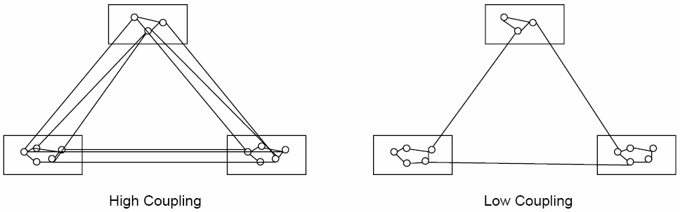
Relationship between Cohesion & Coupling
If the software is not properly modularized, a host of seemingly trivial enhancement or changes will result into death of the project. Therefore, a software engineer must design the modules with goal of high cohesion and low coupling.
Fig. : View of cohesion and coupling

Slide 24
Function Oriented Design
The design process for software systems often has two levels. At the first level the focus is on deciding which modules are needed for the system on the basis of SRS (Software Requirement Specification) and how the modules should be interconnected.
Function Oriented Design is an approach to software design where the design is decomposed into a set of interacting units where each unit has a clearly defined function.
Design Process
The whole system is seen as how data flows in the system by means of data flow diagram.
DFD depicts how functions changes data and state of entire system.
The entire system is logically broken down into smaller units known as functions on the basis of their operation in the system.
Each function is then described at large.

Slide 25
software requirements specification
What is SRS?
A software requirements specification (SRS) is a description of a software system to be developed. It lays out functional and non-functional requirements, and may include a set of use cases that describe user interactions that the software must provide.

Slide 26
Problem Statement
Requirements Elicitation
Requirement Engineering
Requirements Analysis
Requirements Documentation
Requirements Review
SRS
Crucial Process Steps of requirement engineering

Slide 27
Requirements Analysis
We analyze, refine and scrutinize requirements to make consistent & unambiguous requirements.
Steps
Draw the context Diagram
Develop prototype (optional)
Model the Requirements
Finalize the Requirements
Requirements Analysis Steps

Slide 28
Requirements Analysis
Administrator
Marks Entry Operator
Subject Information Entry
Student Information Entry
Marks Entry
Result Management System
Student Information Reports generated
Mark sheet generated
Student performance Reports generated

Slide 29
Requirements Documentation
This is the way of representing requirements in a consistent format
SRS serves many purpose depending upon who is writing it.
--
--
written by customer written by developer
Serves as contract between customer & developer.

Slide 30
Requirements Documentation
Nature of SRS
Basic Issues
Functionality
External Interfaces
Performance
Attributes
Design constraints imposed on an Implementation

Slide 31
Requirements Documentation
Characteristics of a good SRS
An SRS Should be
Correct
Unambiguous
Complete
Consistent
Ranked for important and/or stability
Verifiable
Modifiable
Traceable

Slide 32
Requirements Documentation
Correct
An SRS is correct if and only if every requirement stated therein is one that the software shall meet.
Unambiguous
An SRS is unambiguous if and only if, every requirement stated therein has only one interpretation.
Complete
An SRS is complete if and only if, it includes the following elements
(i) All significant requirements, whether related to functionality, performance, design constraints, attributes or external interfaces.

Slide 33
Responses to both valid & invalid inputs.
Full Label and references to all figures, tables and diagrams in the SRS and definition of all terms and units of measure.
Consistent
An SRS is consistent if and only if, no subset of individual requirements described in it conflict.
Ranked for importance and/or Stability
If an identifier is attached to every requirement to indicate either the importance or stability of that particular requirement.

Slide 34
Requirements Documentation
Verifiable
An SRS is verifiable, if and only if, every requirement stated therein is verifiable.
Modifiable
An SRS is modifiable, if and only if, its structure and style are such that any changes to the requirements can be made easily, completely, and consistently while retaining structure and style.
Traceable
An SRS is traceable, if the origin of each of the requirements is clear and if it facilitates the referencing of each requirement in future development or enhancement
documentation.
34

Slide 35
Organization of the SRS
IEEE has published guidelines and standards to organize an SRS.
IEEE 830-1998 Standard SRS Document.
First two sections are same. The specific tailoring occurs in section-3.
1. Introduction
1.1
1.2
1.3
1.4
1.5
Purpose Scope
Definition, Acronyms and abbreviations References
Overview
35

Slide 36
The Overall Description
Product Perspective
System Interfaces
Interfaces
Hardware Interfaces
Software Interfaces
Communication Interfaces
Memory Constraints
Operations
Site Adaptation Requirements
36

Slide 37
Product Functions
User Characteristics
Constraints
Assumptions for dependencies
Apportioning of requirements
Specific Requirements
External Interfaces
Functions
Performance requirements
Logical database requirements
Design Constraints
Software System attributes
Organization of specific requirements
Additional Comments.
37

